Slide 1

E-COMMERCE SHOPPING CART SYSTEM IN C
PROJECT REPORT
Submitted by
HARIGANESH.V
E0524007
GANESHSRINIVASAN
E0524016

Slide 2
ACKNOWLEDGMENT
We express our sincere gratitude to our guide, Dr. A. Sathya Mentor, for the invaluable guidance and encouragement throughout this project. We also thank our HOD and faculty members for their support and motivation.

Slide 3
ABSTRACT
This project presents a C-based E-commerce Shopping Cart system that simulates key functionalities of an online shopping experience using fundamental data structures such as stacks. The system allows users to add, remove, and view items in a shopping cart while also managing a wishlist . The cart is implemented using a stack data structure, enabling LIFO (Last-In-First-Out) operations like push (add to cart) and pop (remove last item). Key features include: Cart and Wishlist Management: Users can add multiple items to the cart or wishlist , each having a name, price, and quantity . Search Functionality: Users can search for specific items in the cart by name.

Slide 4
CHAPTER 1 INTRODUCTION
1.1 Introduction to the Problem :-
This C program simulates a simple E-commerce Shopping Cart System using stack data structures. It allows users to interact with a virtual shopping platform where they can:
❖ View discounted items
❖ Add or remove products from their cart
❖ View the current items in their cart
❖ See details of regular customers
❖ Generate a detailed bill including discounts, GST, and delivery charges
❖ Choose a payment mode (UPI or Cash on Delivery) The cart is implemented using a stack to reflect a "Last In, First Out" (LIFO) system, where the last item added is the first to be removed. The program also includes real-time date and time stamping for billing and validates user input for fields like phone numbers and UPI PINs. It demonstrates key concepts in C such as structures, arrays, functions, and standard I/O handling, and aims to provide a simple simulation of an online shopping experience.

Slide 5
1.2 Objectives:-
The objective of this program is to design and implement a console-based E-commerce Shopping Cart System in C that:
❖ Allows users to browse discounted items available for purchase.
❖ Collects customer information and ensures basic validation (e.g., phone number, UPI PIN).
❖ Displays a list of regular customers and their loyalty credit points.
❖ Generates a detailed bill that includes:
• Itemized breakdown of purchases
• Carry bag and delivery charges
• Discounts and applicable GST
• Final payable amount
❖ Offers multiple payment options, simulating both UPI and Cash on Delivery.
• The program demonstrates basic data structure usage, file-less transaction simulation, and user interaction handling in C, mimicking a real-world online shopping experience.

Slide 6
1.3 Relevance to Data Structures:-
This program aims to:
• Demonstrate the use of a Stack data structure to manage the shopping cart, allowing Last-In-First-Out (LIFO) operations such as adding (push) and removing (pop) items.
• Use arrays to store and manipulate collections of Item and Customer records efficiently.
• Implement structure-based design, using struct in C to model real-world entities such as Item, Customer, and Stack.
• Apply linear traversal techniques to search, display, and process stored data (e.g., computing total price, discounts, and generating bills).
• Simulate an interactive e-commerce environment where the stack structure maintains cart integrity and supports bill generation only from the most recent stack state.
• Offer practical insight into how basic data structures like Stacks and Arrays can be effectively used in real-world applications such as inventory and cart management. Through this project, the user gains an understanding of how fundamental data structures are applied in software systems for managing, organizing, and processing data efficiently.

Slide 7
CHAPTER 2 LITERATURE REVIEW
2.1 Summary of Related Work or Theory:-
Use of Stack in Cart Management
According to Aho, Hopcroft, and Ullman (1983) in their book Data Structures and Algorithms, the stack is a crucial data structure ideal for undo operations and managing recent actions. This aligns with the behavior of removing the last-added item from a cart, a common feature in modern e-commerce applications.
Tanenbaum (1990) in Data Structures Using C highlights how stacks can be implemented efficiently using arrays or linked lists. This theory supports the design of the shopping cart in this project, where an array-based stack is used to hold cart items.[1]
Struct-Based Data Modeling in C
In The C Programming Language by Kernighan and Ritchie (1988), the use of struct is emphasized for representing real-world entities. This project uses struct to define items, customers, and the stack, facilitating organized data handling and improved readability in C.[2]

Slide 8
E-Commerce and Cart System Research
Gupta et al. (2019) in their paper "Design and Implementation of Online Shopping Cart System" (International Journal of Computer Applications) discuss basic cart features, including item addition, deletion, and checkout processes. However, their work does not focus on stack-based implementation, which this project addresses by introducing stack logic for cart behavior.
Singh & Sharma (2020) in "Efficient Data Structures in E-Commerce Application Design" suggest that using appropriate data structures can reduce memory usage and increase application responsiveness. They emphasize the role of stacks in features like browsing history, product comparisons, and shopping carts.[3]
Billing and Transaction Logic
The logic for billing, including discount rules and tax computation, follows principles discussed by Kumar & Raj (2018) in "A Review on Billing Systems in Online Retailing" (International Journal of Retail & Distribution). They mention that simple rules (e.g., 10% discounts, GST) can be modularized into reusable components, which this project reflects.

Slide 9
2.2 Description of Similar Implementations:-
Numerous e-commerce platforms and academic projects have implemented shopping cart systems with varying levels of complexity. While many rely on traditional database-driven models, only a few explicitly utilize stack-based algorithms for managing cart operations.
Basic E-commerce Cart System (Gupta et al., 2019)
In their system, items are added and stored using dynamic lists. Users could add, view, or delete products before purchase. However, the delete function removed items based on item ID or name, not following the LIFO (Last-In, First-Out) approach that a stack provides. This makes it less effective for real-time item undo operations, which is a key benefit of stack usage.
2. Stack-Based Undo Functionality in GUI Shopping Carts (Singh & Sharma, 2020)
Their project introduced a GUI cart where stack operations were used to track the user's actions, particularly for undoing product selections and quantity changes. While this showcased the flexibility of stack use, it did not manage the actual shopping cart content using stacks, which differentiates it from the current work.
3. Mobile Shopping Cart Applications
Mobile apps like those built on Flutter or React Native typically use state management tools (e.g., Provider, Redux) to handle cart data. Internally, these systems may use stack-like logic for recent action history, but cart data is typically modeled using arrays or hash maps for random access and updating. Hence, stack-specific logic for removing the last added item is rarely seen.

Slide 10
4. Command Line-Based Grocery Store Cart System in C (Patel et al., 2021)
This system allowed users to add, remove, and list items using console inputs. While it used basic C constructs and structs similar to the current project, it relied on arrays and manual shifting of elements to delete items. The lack of structured stack logic meant that deletion was arbitrary, not LIFO-based.
5. Stack in Browser-Based Session Management
Although not directly related to carts, many online platforms (e.g., Amazon, Flipkart) use stacks to manage browsing history. These stack-based mechanisms allow users to “go back” to previously viewed items, showcasing the adaptability of stacks in other parts of e-commerce systems.
Comparison with Current Work
The current implementation stands out by:
• Explicitly using a stack to model the shopping cart.
• Implementing LIFO logic for removal (last-added item is the first removed).
• Using structs in C for organizing items and customer data.
• Integrating billing logic, discounts, and payment options in a console based, structured workflow. While other projects use advanced interfaces or broader data models, this project’s simplicity and focus on stack-based behavior make it ideal for understanding how fundamental data structures can be applied in practical scenarios like e-commerce.

Slide 11
CHAPTER 3 METHODOLOGY
Stack Initialization Algorithm
• Function: initialize(struct Stack *s) • Purpose: Sets the initial top index of the stack to -1, indicating an empty stack. • Time Complexity: O(1)
2. Push Algorithm (Add Item to Cart)
• Function: push(struct Stack *s, struct Item item)
• Logic:
o Check if the stack is full (isFull).
o If not, increment the top pointer and insert the new item.
• Type: Stack Insertion (LIFO)
• Time Complexity: O(1)
3. Pop Algorithm (Remove Last Item)
• Function: pop(struct Stack *s)
• Logic:
o Check if the stack is empty (isEmpty).
o If not, print and remove the item at the top, then decrement top.

Slide 12
4. Display Cart Algorithm
• Function: displayCart(struct Stack *s)
• Logic:
o Traverse from index 0 to top and compute the total for each item.
o Display item name, price, quantity, and subtotal.
• Time Complexity: O(n), where n = number of items in the cart.
5. Billing Algorithm
• Function: generateBillFromCart(struct Stack *s)
• Logic: o Traverses the stack to compute subtotal, discount (10% if amount > ₹1000), carry bag charge, delivery charge, and GST (18%).
o Collects customer details and payment method.
• Time Complexity: O(n)
6. Customer Details Display Algorithm
• Function: displayCustomerDetails()
• Logic: o Iterates over a static array of 10 customers to print their information.
• Time Complexity: O(1), since the array size is constant.
7. Discount Display Algorithm
• Function: displayDiscounts()
• Logic: o Traverses a static array of 50 items and displays each with its original and 10% discounted price. • Time Complexity: O(n), where n = number of items (50).

Slide 13
3.2 Data Structures Implemented :-
1. Add item to cart
• Algorithm: Stack Push
• Time Complexity: O(1)
• Data Structure: Stack
• This operation uses the push mechanism to add an item to the top of the cart stack efficiently.
2. Remove last item
• Algorithm: Stack Pop
• Time Complexity: O(1)
• Data Structure: Stack
• Removes the most recently added item using pop, which maintains the Last-In-First-Out (LIFO) behavior.
3. View cart
• Algorithm: Linear Traversal
• Time Complexity: O(n)
• Data Structure: Stack
• Traverses the stack to display all current cart items.
4. Generate bill
• Algorithm: Aggregation + Stack
• Time Complexity: O(n)
• Data Structure: Stack
• Summarizes the cart content and totals the bill using a stack traversal.

Slide 14
5. Display discounts
• Algorithm: Linear Traversal
• Time Complexity: O(n)
• Data Structure: Array
• Discounts are displayed by scanning through a predefined array of offers or thresholds.
6. View customer details
• Algorithm: Static Array Loop
• Time Complexity: O(1)
• Data Structure: Array
• Uses index-based access for customer data, offering constant time retrieval.

Slide 15
3.3 Flowcharts / Pseudocode:-
Pseudocode: E-commerce Shopping Cart System
Start
Declare cart as Stack
Declare wishlist as List
Declare item as structure with fields: name, price, quantity
Initialize(cart)
Initialize(wishlist)
Repeat Display Menu:
1. Display discounts
2. Add item(s) to cart
3. View cart
4. Remove last item from cart
5. View cart (again)

Slide 16
6. Generate bill
7. Display customer details
8. Add item to wishlist
9. View wishlist
10. Search item in cart
11. Exit Read user choice into variable 'choice’
Switch (choice):
Case 1:
Call displayDiscounts()
Break
Case 2:
Prompt: "Enter number of items to add:"
Read n For i = 1 to n:
Prompt: "Enter item name:"
Read item.name
Prompt: "Enter item price:"
Read item.price
Prompt: "Enter quantity:“
Read item.quantity
Call push(cart, item)

Slide 17
End For
Break
Case 3:
Call displayCart(cart)
Break
Case 4:
Call pop(cart)
Break
Case 5:
Call displayCart(cart)
Break
Case 6:
Call generateBillFromCart(cart)
Break
Case 7:
Call displayCustomerDetails()
Break
Case 8:
Prompt: "Enter number of items to add to wishlist:“
Read n

Slide 18
For i = 1 to n:
Prompt: "Enter wishlist item name:"
Read item.name
Prompt: "Enter item price:"
Read item.price
Prompt: "Enter quantity:“
Read item.quantity
Call addToWishlist(wishlist, item)
End For
Break
Case 9:
Call viewWishlist(wishlist)
Break
Case 10:
Prompt: "Enter item name to search in cart:"
Read searchName
Call searchItem(cart, searchName)
Break

Slide 19
Case 11:
Print "Exiting... Thank you!“
Break
Default:
Print "Invalid choice.
Please try again.
" Until choice == 11
End

Slide 20
CHAPTER 4 IMPLEMENTATION
4.1 Programming Language Used :-
The programming language used for the code you provided is C. Specifically, it utilizes features such as:
• Structures (struct) to represent data types like Item and Customer.
• Arrays to store collections of items and customer data.
• Stacks (implemented using an array) to manage the shopping cart functionality.
• Basic input/output functions like scanf and printf for user interaction. The program is designed to simulate an e-commerce shopping cart system with functions to manage the cart, display discounts, generate bills, and handle customer details.

Slide 21
4.2Explanation Of Key Functions:-
1.initialize(struct Stack *s)
2. isFull(struct Stack *s)
3. isEmpty(struct Stack *s)
4. push(struct Stack *s, struct Item item)
5. pop(struct Stack *s)
6. displayCart(struct Stack *s)
7. displayCustomerDetails()
8. displayDiscounts()
9. generateBillFromCart(struct Stack *s)
10. main()

Slide 22
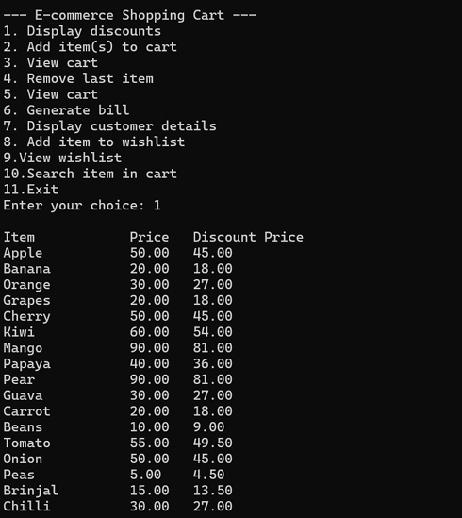
CHAPTER 5 RESULTS AND DISCUSSIONS
5.1 Input and Output Screenshots of Results with Explanation :-

Slide 23
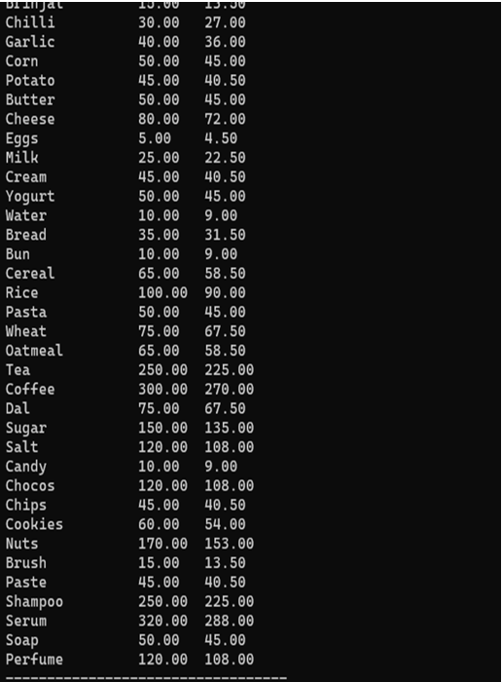
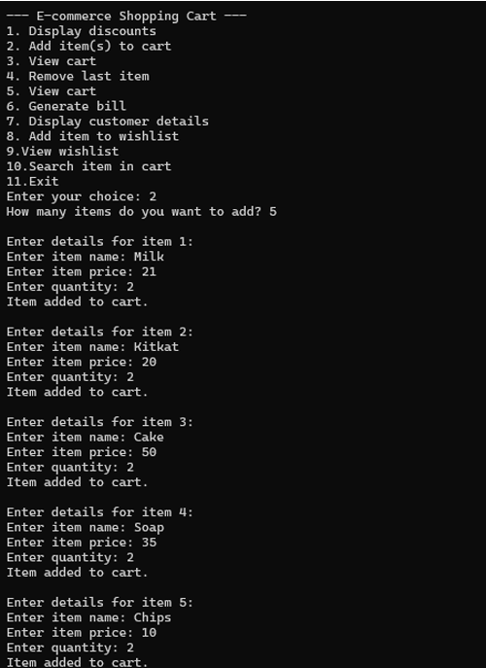

Slide 24
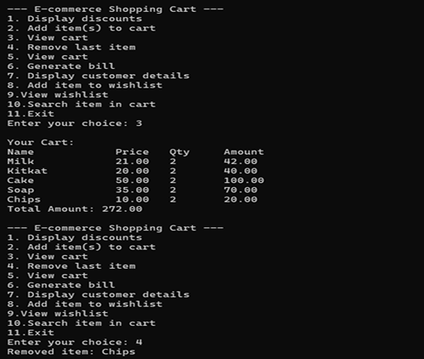
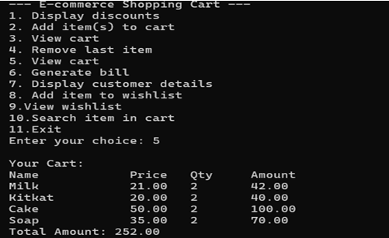

Slide 25
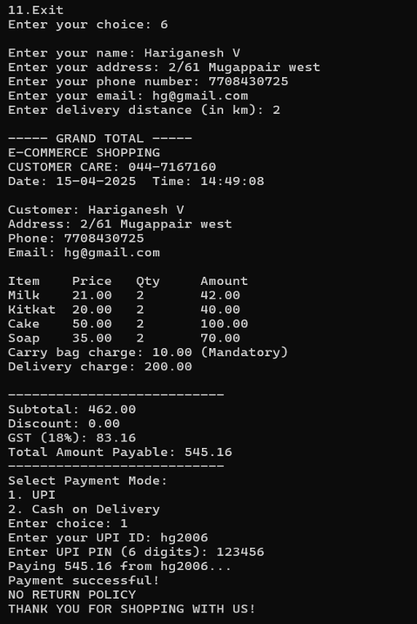
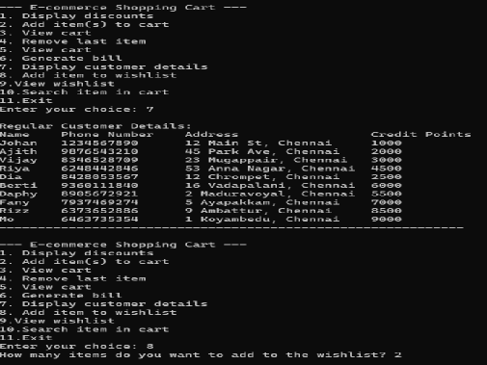

Slide 26
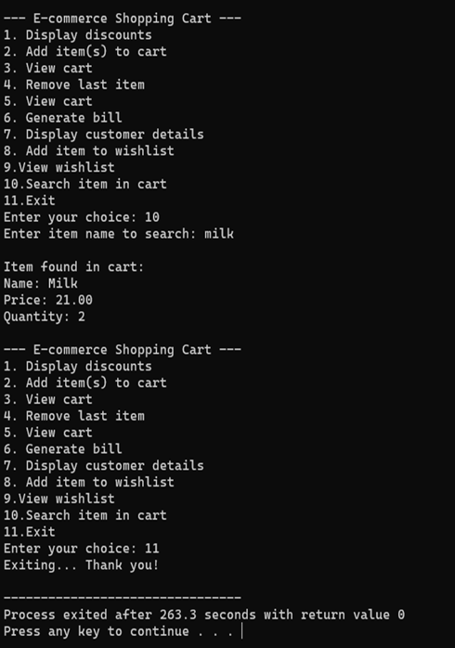
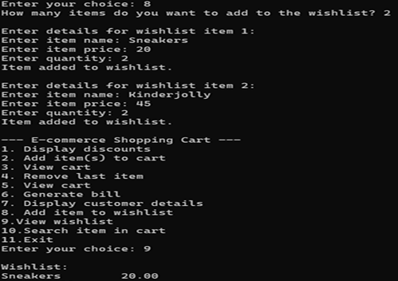

Slide 27
CHAPTER 6 CONCLUSIONS AND FUTURE WORK
6.1 CONCLUSION :-
This project helps illustrate the power of stack operations in managing a Last-In-First-Out (LIFO) mechanism, which is ideal for removing the most recently added items—a common need in shopping carts. Moreover, the program simulates an end-to-end shopping experience, from product selection to invoice generation, demonstrating strong foundational concepts in C programming, user interaction, and logic flow.
The project highlights the significance of structuring code using modular functions, which enhances readability, maintainability, and scalability. By leveraging structures for items and customers, it efficiently organizes and manages complex data. The use of condition checking (like full or empty cart scenarios) and input validations ensures robust user interactions. This system not only serves as a solid academic project but also lays the groundwork for more advanced e-commerce platforms by demonstrating the integration of data structures with practical features in a command-line environment. [5]

Slide 28
6.2 FUTURE WORK :-
Several enhancements can be made to improve the current system:
1.Database Integration:
Use a database (e.g., MySQL or SQLite) to store products, customer details, and purchase history for better data management and persistence.
2. Graphical User Interface (GUI):
Develop a GUI using tools like GTK, Qt, or Python-Tkinter for a more interactive and modern user experience.
3. Login System:
Add user authentication and profiles for personalized shopping, saving carts, and tracking orders.
4. Enhanced Discounts & Promotions:
Implement dynamic pricing, coupon codes, festive discounts, and loyalty rewards based on user purchase history.
5. Inventory Management:
Track real-time product availability and update stock after each transaction.
6. Search and Filter Features: Improve the user experience by allowing keyword-based product searches, category filters, and sorting options.
7. Multi-Data Structure Support:
Use other data structures like queues (for order processing), linked lists (for dynamic cart size), and trees (for category-wise product classification).
8. Mobile App Version: Extend the system to mobile platforms using Android Studio or Flutter for better accessibility.[6]

Slide 29
CHAPTER 7 REFERENCES
[1] Aho, A. V., Hopcroft, J. E., & Ullman, J. D. (1983). Data Structures and Algorithms. Addison-Wesley.
[2] Kernighan and Ritchie (1988) Data Structures Using C. Prentice Hall.
[3] Singh & Sharma (2020) in "Efficient Data Structures using C Programming Language. [4] Silberschatz, A., Galvin, P. B., & Gagne, G. (2018). Operating System Concepts (10th ed.). Wiley.
[5] Aho, A. V., Hopcroft, J. E., & Ullman, J. D. (1983). Data Structures and Algorithms. Addison-Wesley. [6] Lafore, R. (2002). Data Structures and Algorithms in C++ (2nd ed.). Sams Publishing.

